Slide 1

Your success is our success
Explore & Understand SOAP API
- API Assignments 04
Funny Gorilla诙猩猩-IT培训

Slide 2
Prerequisites:
Gitbash (for Windows only)

Slide 3
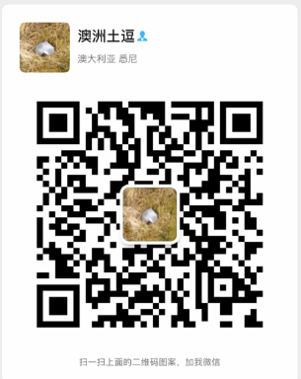
Your success is our success
Contact
Mail: info@funnygorilla.com.au
Linkedin: https://mt.linkedin.com/in/songqing-gu-2ba9034b/de
Web Chat: FunnyGorilla
Phone: 0420891343

